Slide 1
The Battle of Neighborhoods
Capstone project for Coursera IBM Data science professional certificate
Pierayeh Vahdani

Slide 2
Introduction: Business Problem
Data
Methodology
Results and Analysis
Discussion
Conclusion

Slide 3
Business Problem
In this project, I will compare the neighborhood of the city of Vancouver and the city of Toronto.
The purpose of the project is for a chain restaurant that would like to open a new branch in each city and tries to search to find the best location and a customized menu for each location.
The restaurant considers 2 factors to decide about the location and the menu as follow:
The location should be in a popular neighborhood that can attract visitors.
The menu for each location should includes foods that are less offered by other restaurants in the that neighborhood.

Slide 4
Data
Following data sources will be needed to extract/generate the required information:
centers of candidate areas will be generated algorithmically and approximate addresses of centers of those areas will be obtained using Wikipedia
number of restaurants and their type and location in every neighborhood will be obtained using Foursquare API
Coordinate of Vancouver and its neighborhoods will be obtained using ‘the government of British Columbi's BC Address Geocoder website’.

Slide 5
Methodology
Based on definition of our problem, factors that will influence our decision are:
1- Location:
Number of existing restaurants and other public venues such as parks, beaches, museums in the neighborhood.
Distance of neighborhood from city center.
2- The menu:
The dishes that are less offered by the restaurants in that neighborhood.

Slide 6
Data from Wikipedia containing the borough, neighborhoods, and the associated postal codes is collected and converted to a pandas dataframe.
Data including Vancouver borough, postal codes, and their corresponding geographical information is obtained from the government of BC address Geocoder website and converted to a pandas dataframe. I renamed some columns and re-indexd the dataframe.
I used FourSquare to get 100 venues in Vancouver , then explored and clustered the neighborhoods in Vancouver and visualized the neighborhoods and how they clustered together.

Slide 7
The top 3 neighborhoods with the largest number of venues are:
West Mount Pleasant, West Riley Park, Little Mountain
North West Dunbar, Southlands, Chaldecutt, South University Endowment Lands
SW Downtown

Slide 8
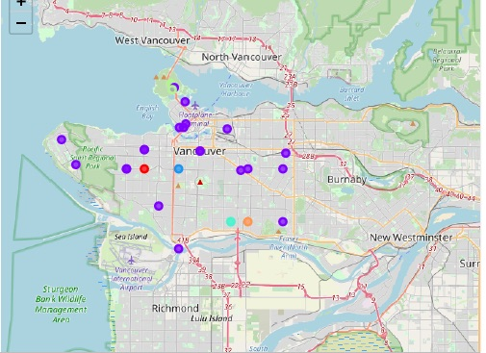
Map of Vancouver and different venues divided into 6 different cluster

Slide 9
I repeated the same process for the city of Toronto. The top 10 neighborhoods in Toronto with largest number of venues are:
First Canadian Place
Harbourfront East, Union Station, Toronto Islands
Garden District, Ryerson
Toronto Dominion Center, Design Exchange
Commerce Court, Victoria Hotel
Stn A P0 Boxes
Richmond, Adelaide, King
Church and Wellesley
St. James Town
Central Bay Street

Slide 10
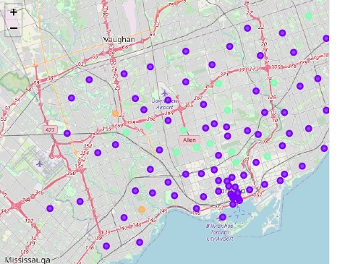
Map of Toronto and different venues divided into 6 different cluster

Slide 11
Discussion
1. Vancouver neighborhoods
All the top 3 neighborhoods in Vancouver are included in cluster number 2, which is the biggest cluster, shown in the figure with purple circles.
Looking at top 10 most common venues in these neighborhoods, I concluded that Japanese, Chinese, Korean restaurants are the most common restaurants in these neighborhoods.
The most common places in the second biggest cluster in Vancouver, cluster number 5, are Parks, lakes, and trials which attract many visitors specially during weekends.
I would recommend to the chain restaurant to open a new branch in cluster number 2, best neighborhoods are those listed in the top 3 neighborhoods, or in the the neighborhoods within cluster number 5.
I also recommend to customize the menu to include more Italian, Mexican, Mediterranean style of food.

Slide 12
All top 10 neighborhoods in Toronto are included in cluster number 1, which is the biggest cluster, shown in the figure with purple circles.
Looking at top 10 most common venues in these neighborhoods, I concluded that Japanese, Chinese, Korean restaurants are the most common restaurants in these neighborhoods.
I would recommend to the chain restaurant to open a new branch in cluster number 2, best neighborhoods are those listed in the top 3 neighborhoods, or in the the neighborhoods within cluster number 5.
I also recommend to customize the menu to include more Italian, Mexican, Mediterranean style of food.

Slide 13
Conclusion
I demonstrated how to cluster and segment different neighborhoods in the central part of the city of Toronto and the city of Vancouver based on the venues in these neighborhoods.
I used the results of this analysis to recommend to a chain restaurant the best neighborhoods in these two cities to open a new branch and a customized menu which includes the foods that are less commonly found in those neighborhoods.
This project include Boroughs that are limited to the central part of the cities and not includes other interesting Boroughs, For example the data for North Vancouver and West Vancouver with potential attractive places was missing in this analysis.
To improve the analysis, I would recommend to collect larger data set which includes other Boroughs to have a better understanding of different neighborhoods in both cities to open more branches in them.

